Slide 1



SESSION NAME HERE
The Stack and the Heap

Slide 2


Foundational Sessions Housekeeping
The use of disrespectful language is prohibited in the questions, this is a supportive, learning environment for all - please engage accordingly. (FBV: Mutual Respect.)
No question is daft or silly - ask them!
There are Q&A sessions midway and at the end of the session, should you wish to ask any follow-up questions. Moderators are going to be answering questions as the session progresses as well.
If you have any questions outside of this lecture, or that are not answered during this lecture, please do submit these for upcoming Open Classes. You can submit these questions here:
SE Open Class Questions or DS Open Class Questions

Slide 3
Foundational Sessions Housekeeping cont.
For all non-academic questions, please submit a query: www.hyperiondev.com/support
Report a safeguarding incident: www.hyperiondev.com/safeguardreporting
We would love your feedback on lectures: Feedback on Lectures

Slide 4


Reminders!
Guided Learning Hours
By now, ideally you should have 7 GLHs per week accrued. Remember to attend any and all sessions for support, and to ensure you reach 112 GLHs by the close of your Skills Bootcamp.
CONFIDENTIAL

Slide 5
Progression Criteria
✅ Criterion 1: Initial Requirements
Complete 15 hours of Guided Learning Hours and the first four tasks within two weeks.
✅ Criterion 2: Mid-Course Progress
Software Engineering: Finish 14 tasks by week 8.
Data Science: Finish 13 tasks by week 8.
✅ Criterion 3: Post-Course Progress
Complete all mandatory tasks by 24th March 2024.
Record an Invitation to Interview within 4 weeks of course completion, or by 30th March 2024.
Achieve 112 GLH by 24th March 2024.
✅ Criterion 4: Employability
Record a Final Job Outcome within 12 weeks of graduation, or by 23rd September 2024.
CONFIDENTIAL

Slide 6

The Stack and the Heap
Memory Management in Python
Stack vs Heap
Data Flow
Stack vs Heap Allocation
Example

Slide 7

Memory Management
The function responsible for managing the computer's primary memory. It tracks the status of each memory location, either allocated or free, and decides how memory is allocated and deallocated among competing processes.

Slide 8
Stack vs Heap
 | Stack Memory | Heap Memory
Data Storage | Stores temporary data by functions | Stores data not tied to a specific function
Insertion | LIFO data structure | No specific order
Deletion | Automatic allocation and deallocation of memory | Dynamic allocation and deallocation during runtime
Memory Size | Limited, fixed size | Dynamically adjusted size
Management | Easy to manage | More challenging
Access Speed | Faster access | Slower access
Data Storage Size | Used for small amount of data | Used for large, complex data structures

Slide 9
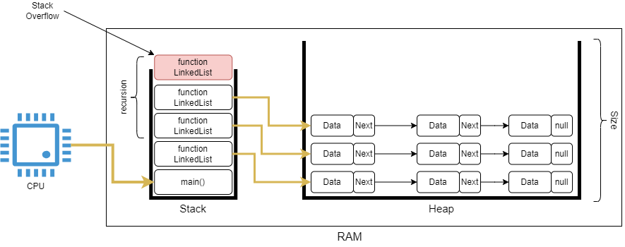
Data Flow

Slide 10

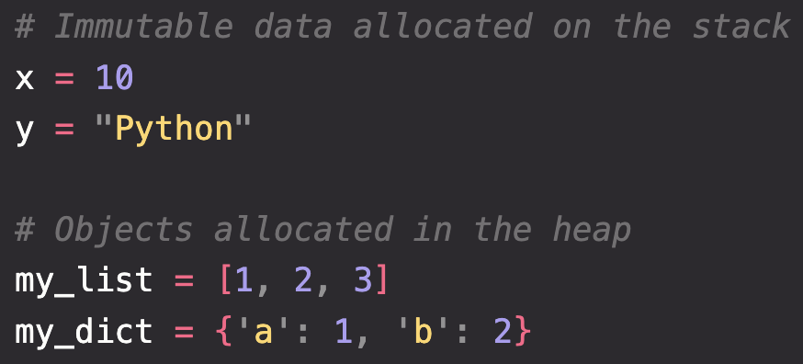
Example: Python Variables and Memory Allocation

Slide 11
Summary
Memory Management in Python
Python's memory management involves two key areas: the stack for static memory allocation and the heap for dynamic memory allocation, with mechanisms for garbage collection and reference counting to manage memory usage efficiently.
The Stack
The stack is a last-in-first-out (LIFO) structure used for storing function call information and local variables, automatically managed by the system, with data being deleted as soon as its scope ends.

Slide 12
Summary
The Heap
The heap is a larger pool of memory used for objects that outlive a single function call, such as global variables and objects created within functions, which require manual management and garbage collection to avoid memory leaks.
Stack vs Heap Allocation
Stack allocation is quick and automatically managed, suitable for temporary or local variables, whereas heap allocation is necessary for objects whose lifetime is longer or not easily determined, managed by the Python memory allocator.

Slide 13
Summary
Recursion and Stack Overflow
Recursive function calls each add a new frame to the stack, which can lead to a stack overflow if the recursion is too deep or improperly managed; this is mitigated by limiting recursion depth or using alternative algorithms.
Iterative vs Recursive Functions
Iterative functions are often preferred over recursive ones for their efficiency and lower memory footprint, particularly in languages like Python that lack tail-call optimization, thus preventing stack overflow in large computations.

Slide 14
Further Learning & References
Real Python - Memory Management in Python
https://pythontutor.com
GeeksforGeeks - Memory Management in Python
Stack Abuse - Basics of Memory Management in Python
Scout APM Blog - Python Memory Management: The Essential Guide

Slide 15


Thank you
for joining us
Take regular breaks
Stay hydrated
Avoid prolonged screen time
Practice good posture
Get regular exercise
“With great power comes great responsibility”

Slide 16


Questions and Answers
Questions around Stack and the Heap

